Slide 1

New York City’s Environmental Policy Implementation - from the perspective of Technology and Innovation
William Steimel (Henry)
B1778102 –
Green Science and Engineering

Slide 2
Table of Contents
New York City (NYC) Background
SDG 11
NYC Problems/Challenges
NYC’s Plan
NYC’s Ambitious Goals
NYC’s Progress Report
Paris Climate Agreement
New York’s Technology Plan
New York Examples of Public Participation Through Technology
Conclusion

Slide 3
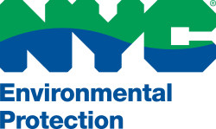
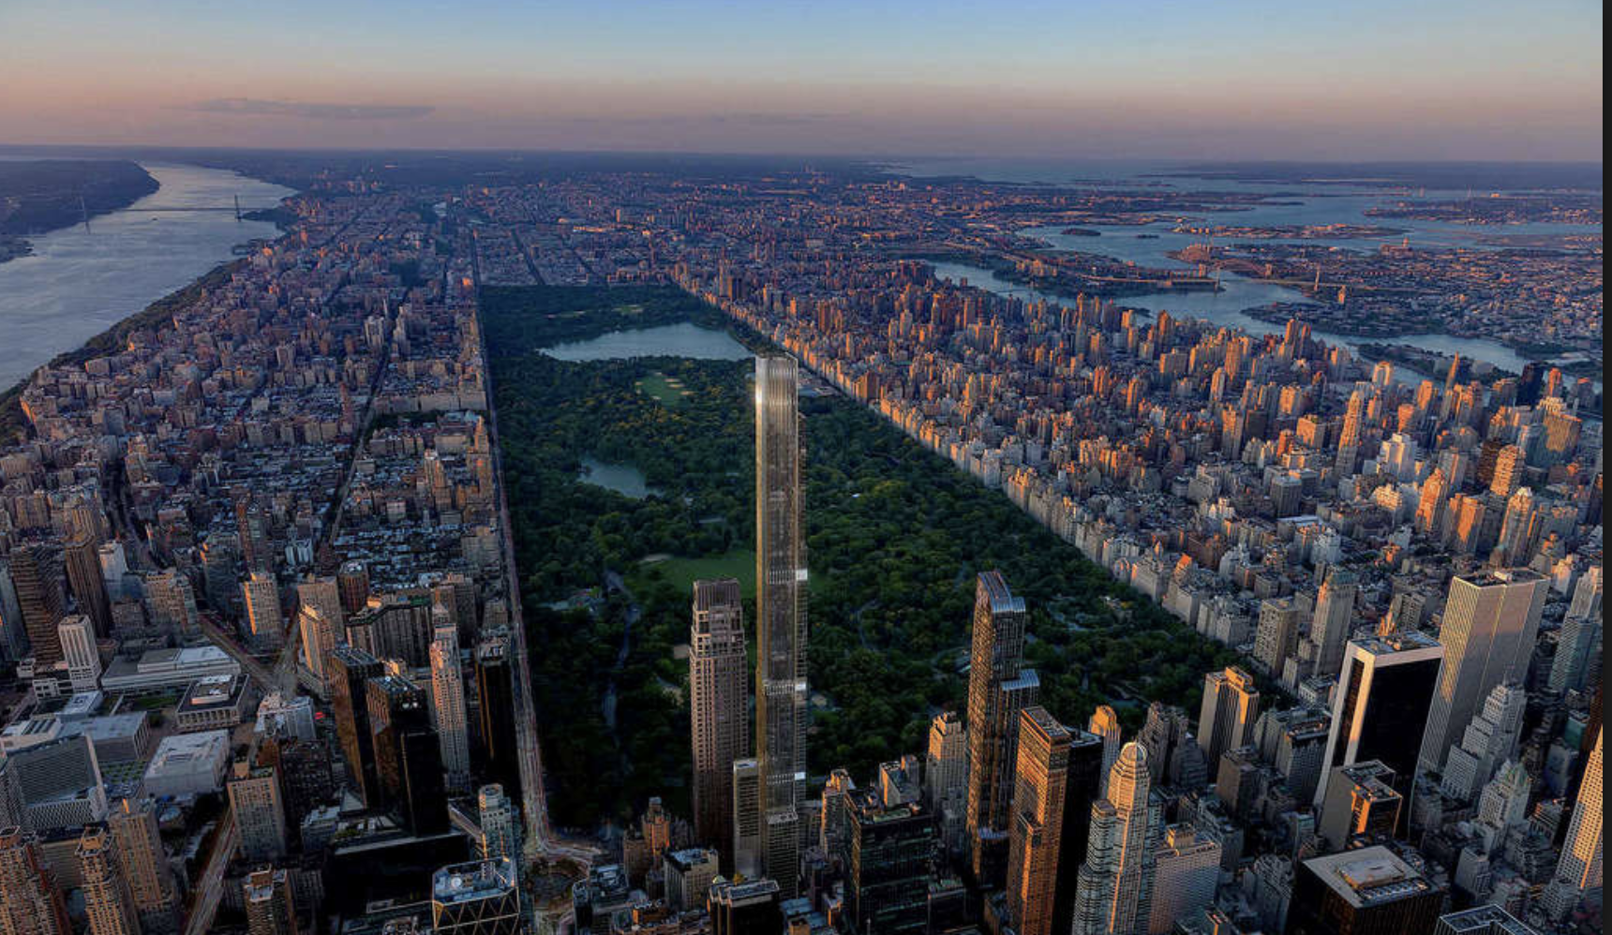
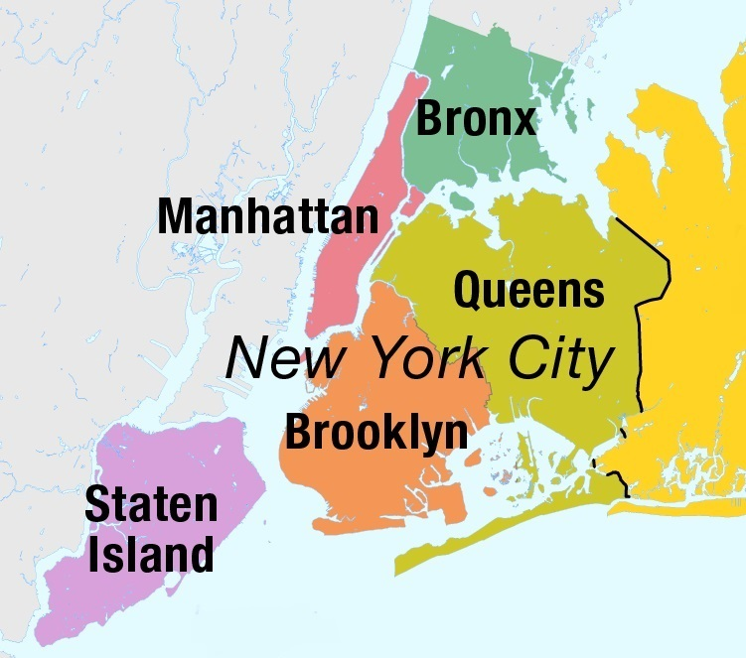
New York City Background
Settled 1624
Mayor – Bill de Blasio
5 Boroughs
The Bronx
Brooklyn
Manhattan
Queens
Staten Island
Population 2018 (Est. 8.4 Million)
Elevation – 10 m

Slide 4

Sustainable Development Goal 11
SDG 11 – In 2015, close to 4 billion people — 54 per cent of the world’s population — lived in cities and that number is projected to increase to about 5 billion people by 2030 (United Nations)
More are projected to live in Cities in the future and they are often considered the greatest polluters of the environment
Big Cities like New York and cities around the world need to work to reduce their impact on the environment

Slide 5
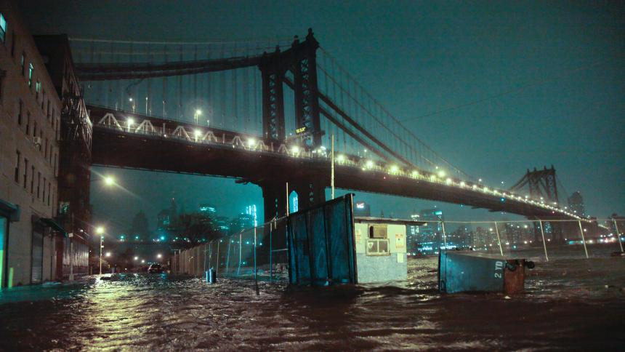
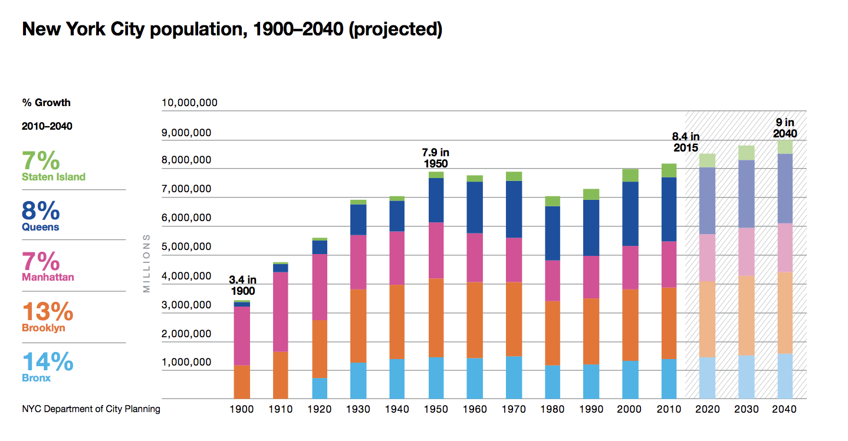
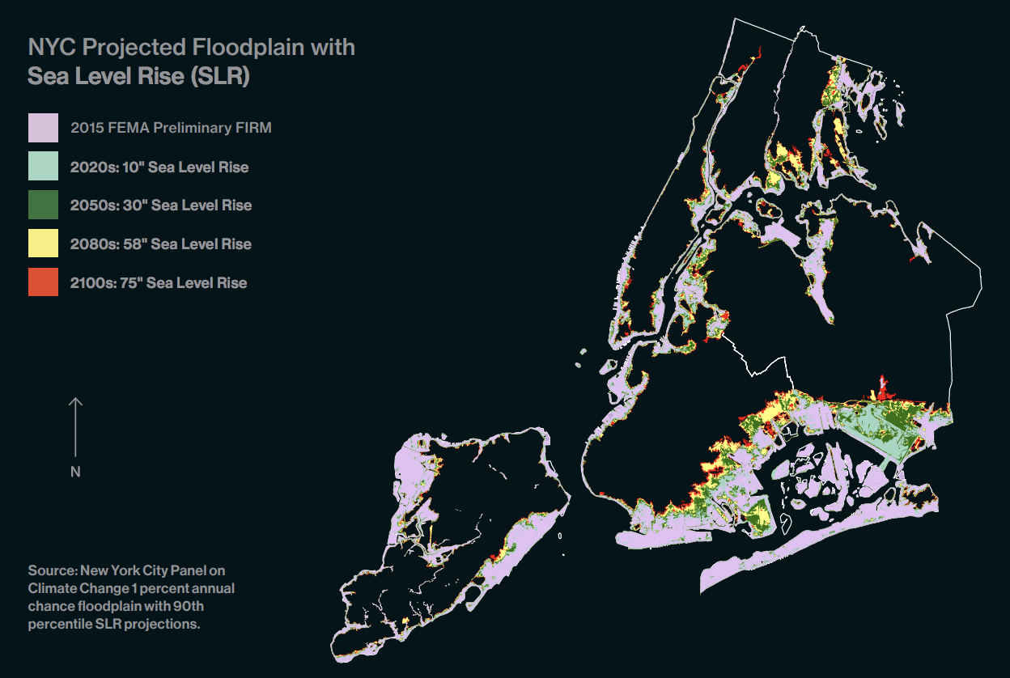
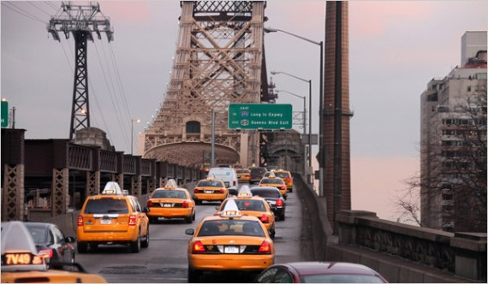
Problem/Challenges
1. New York City is expected to grow from a population of 8.4 Million to 9 Million by 2040.
New York as a city needs to be able to handle this growth sustainably
2. NYC is surrounded by water and at risk of future sea level rise due to Climate Change.
Currently - Heavily Impacted by Flooding during Hurricanes
3. Congestion/Traffic
Car Idling/Pollution/Taxis
4. Aging Infrastructure
Inefficient Energy Systems
It is important for New York City to adapt smart Environmental policy and implementation of smart city technology to address these future challenges.
Population Projections
Flooding (Hurricane Sandy)-2012
Sea-Level Rise-
OneNYC Progress Report 2018
Road Congestion/Aging Infrastructure

Slide 6
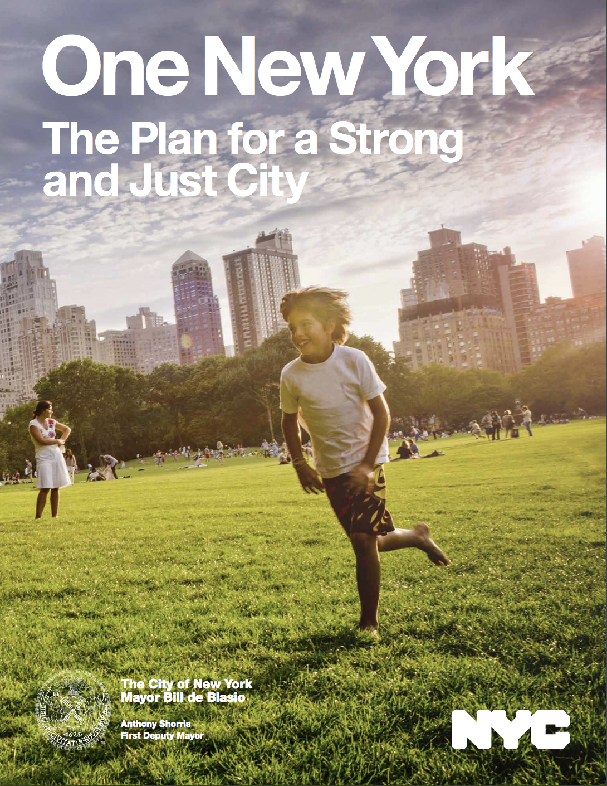
New York’s Plan
OneNYC:
Goal - to make New York the most resilient, equitable, and sustainable city in the world
This plan was made with the consultation of various stakeholders (Focus on Public Participation)
7,500 New Yorkers (Online Survey)
800 New Yorkers (Telephone Survey)
1300 + Residents attended more than 40 community meetings
177 civic organizations and 50 + elected official offices
15 leaders from neighboring cities and counties
125 representatives from over 70 city agencies developed the plan
This plan takes these inputs and aims for a Holistic Perspective in solving all of the cities problems and challenges. (5 pillars)
Growth
Equity
Sustainability
Resiliency
Diversity & Inclusivity

Slide 7
NYC’s Ambitious Goals (Sustainability)
Initiative 1 – 80x50
Reduce the city’s greenhouse gas emissions by 80 percent by 2050 relative to 2005 levels (80x50)
Initiative 2- Zero Waste
Reduce Volume of DSNY-collected refuse by 90 percent relative to 2005 baseline of 3.6 tons
Increase curbside and containerized diversion from a rate of 15.4 % in 2014
Initiative 3- Air Quality
Air quality ranking amount major U.S Cities (Target is 1st)
Disparity in SO2 across city neighborhoods
Disparity in PM2.5 Levels across city neighborhoods
Initiative 4 – Brownfields
Number of Tax Lots Remediated Since January 1, 2014
Initiative 5- Water Management
0 Violations with Safe Drinking Water
Backlog of catch basic repairs
Combined Sewer Overflow Capture Rate
Initiative 6- Parks & Natural Resources
Increase percent of New Yorkers living within walking distance to a park from 79.5 % to 85 percent by 2030

Slide 8
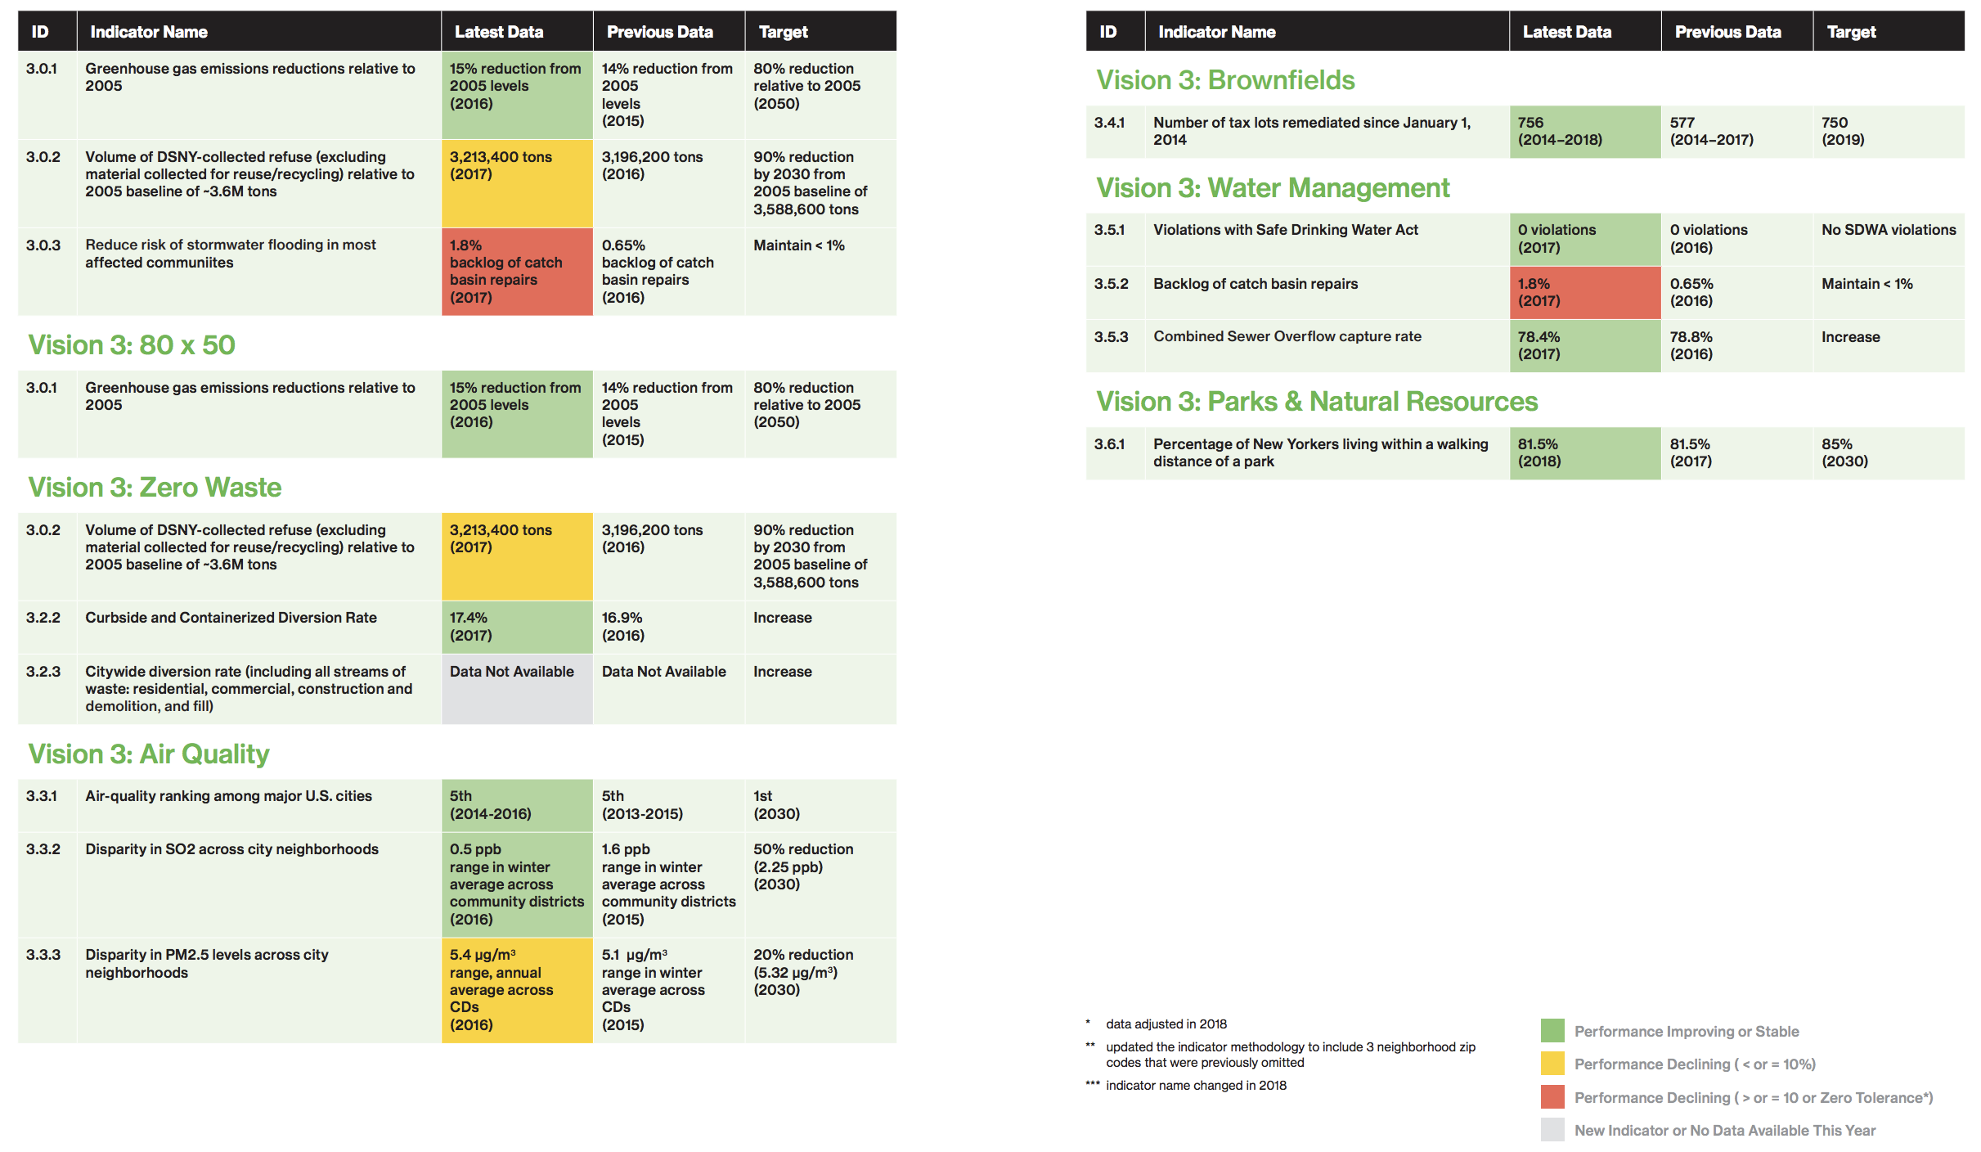
NYC Progress Report (2018)

Slide 9
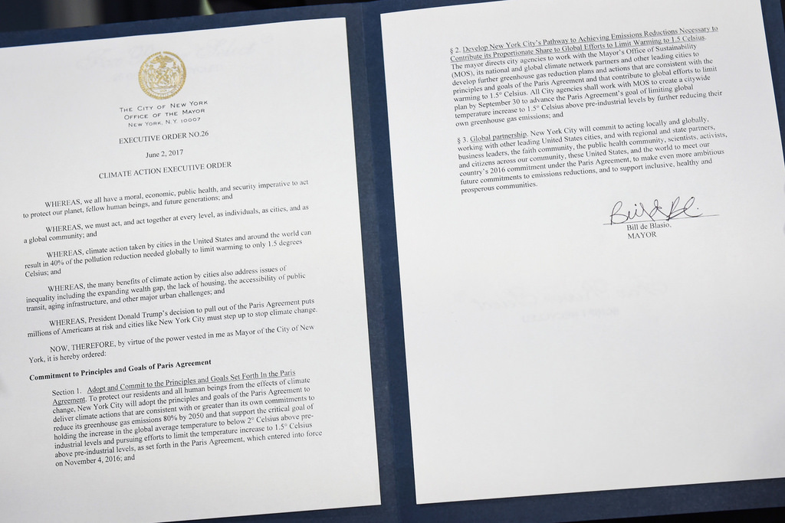
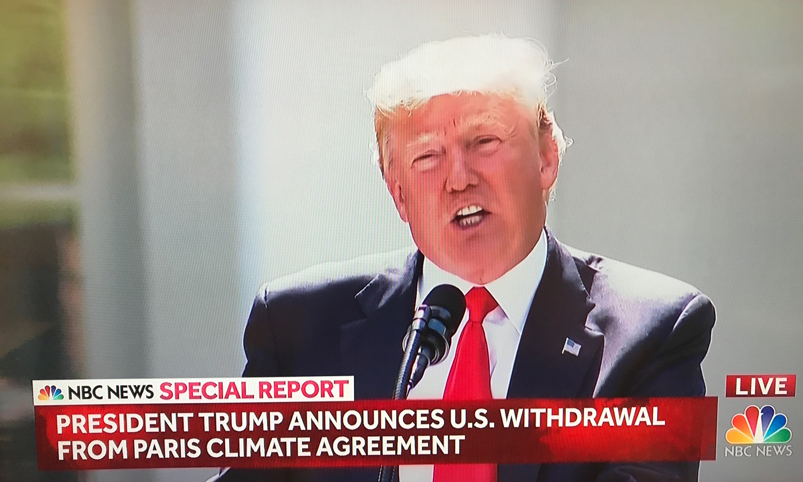
Paris Climate Agreement
June 1, 2017 – President Trump announced his intention to withdraw from the Paris Agreement
June 2, 2017 – Mayor de Blasio signs executive order 26, committing New York City to the Paris Agreement (Direct Defiance to Trump)
This is an example of Top-Down Decision Making

Slide 10
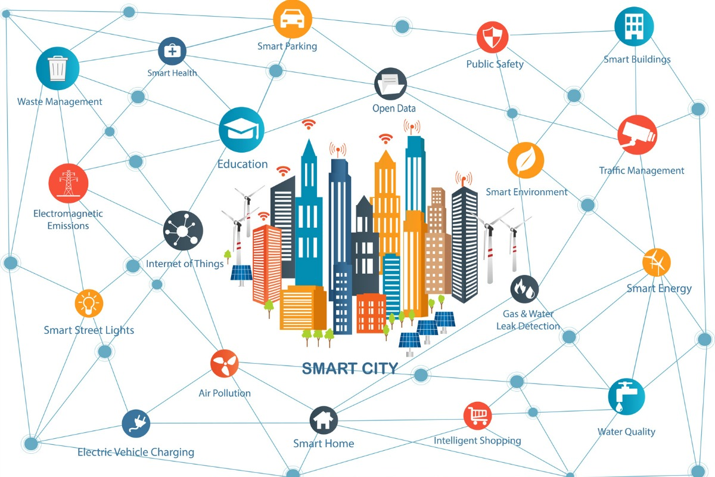
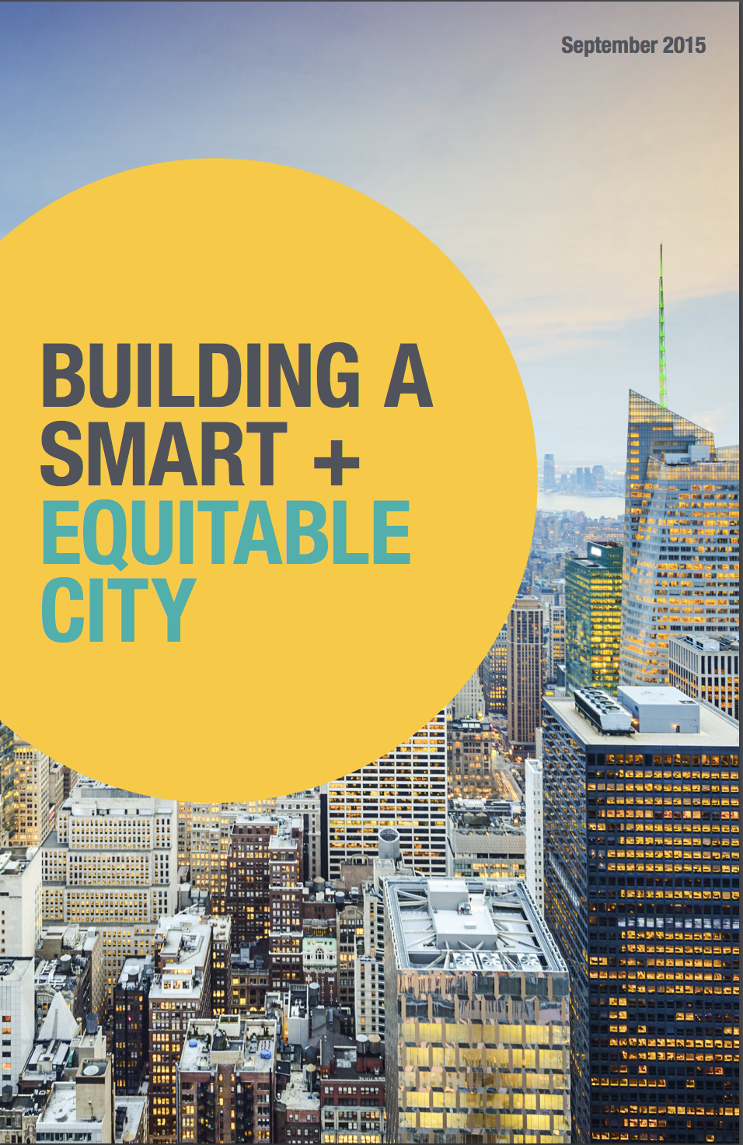
New York’s Technology Plan
New York is very aggressively leveraging technology and aiming to be the “smartest city” in the world to achieve these policy goals/targets
Building a Smart + Equitable City (2015)
Published by Mayor’s Office of Technology and Innovation
10 Case Studies on how NYC is leveraging Smart City Technology
Sustainability related cases: (IoT – Internet of Things utilized)
Smart Indoor Lighting (Over 110 energy saving projects across 18 city agencies)
Wireless Water Meters (Connecting residents to their water usage data online)
Responsive Traffic Management (Real Time Analysis on Roads to improve flow of traffic and decrease carbon emissions)
Smart Waste Management (NYC has the world’s largest sanitation department and they are deploying smart trash cans with wireless sensors that detect trash levels to optimize waste collection)
Water Quality Monitoring (Constant Real Time Quality Monitoring)
Air Quality Monitoring (Data-driven air quality management)
2016 Best Smart City Award – Smart City Expo World Congress – Spain

Slide 11

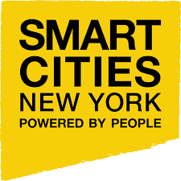

New York Examples of Public Participation Through Technology
NYC Open Data
Being Informed is key to Public Participation - Gives Chances for normal citizens to look up statistics and data related to their community and direct environment
Empowering people in the digital age - Gives opportunities to entrepreneurs to utilize data and build innovative tools for the city
Increased Transparency – All Environmental Datasets (Air Pollution, Water Quality, Traffic Flow Data Etc.) are available as well as current targets and progress
Smart Cities NYC – North America’s leading global conference for smart cities – Addressing challenges of cities around the world
Smart Cities NYC 2017 – Focused on importance of Citizen Participation in making cities “Smart”
Objective: “Facilitating Access to Public-Private Partnerships to Build Smart and Resilient Cities”
Urban Tech NYC (NYC Mayor’s Office of Tech + Innovation)
New York’s Entrepreneurship Ecosystem that facilitates innovation by supporting entrepreneurs who make the city more sustainable, resilient, and livable.
Innovation Lab

Slide 12
Conclusion
New York’s Environmental Policy is quite progressive in the United States and I look forward to monitoring their process towards achieving their goals.
Their method of measurement (Environmental KPI’s) helps promote transparency and public participation in many stages from citizen to entrepreneur
New York is taking some innovative approaches to ensure they are not only a smart and sustainable city in the future but also a city that is desirable to live in for potential intellectual capital who could contribute even further to development of the city

Slide 13
Sources
Goal 11 .:. Sustainable Development Knowledge Platform. (n.d.). Retrieved from https://sustainabledevelopment.un.org/sdg11https://onenyc.cityofnewyork.us/wp-content/uploads/2018/04/OneNYC-1.pdf
United States, City of New York, Mayor Bill DeBlasio. (2018). Progress Report OneNYC 2018. Retrieved from https://onenyc.cityofnewyork.us/wp-content/uploads/2018/05/OneNYC_Progress_2018.pdf
United States, City of New York, Mayors Office of Technology and Innovation. (2015, September). Building a Smart Equitable City. Retrieved from https://www1.nyc.gov/assets/forward/documents/NYC-Smart-Equitable-City-Final.pdf
New York Named "2016 Best Smart City," NYC To Host International Conference On Urban Technology. (2016, November 28). Retrieved from https://www1.nyc.gov/office-of-the-mayor/news/909-16/new-york-named-2016-best-smart-city-nyc-host-2017-international-conference-urban
: City of New York, NYC Open Data. (n.d.). NYC Open Data. Retrieved from https://opendata.cityofnewyork.us/
Smart Cities NY. (n.d.). Retrieved from https://smartcitiesny.com/
Urban Tech Nyc. (n.d.). Retrieved from http://www.urbantechnyc.com/#ecosystem

